Slide 1

A Successive Convexification Optimal Guidance Implementation for the Pinpoint Landing of Space Vehicles
Pádraig Lysandrou

Slide 2
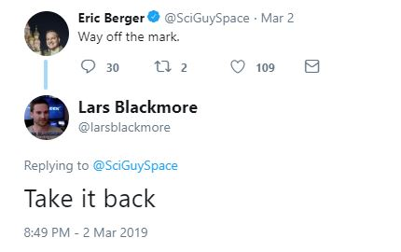
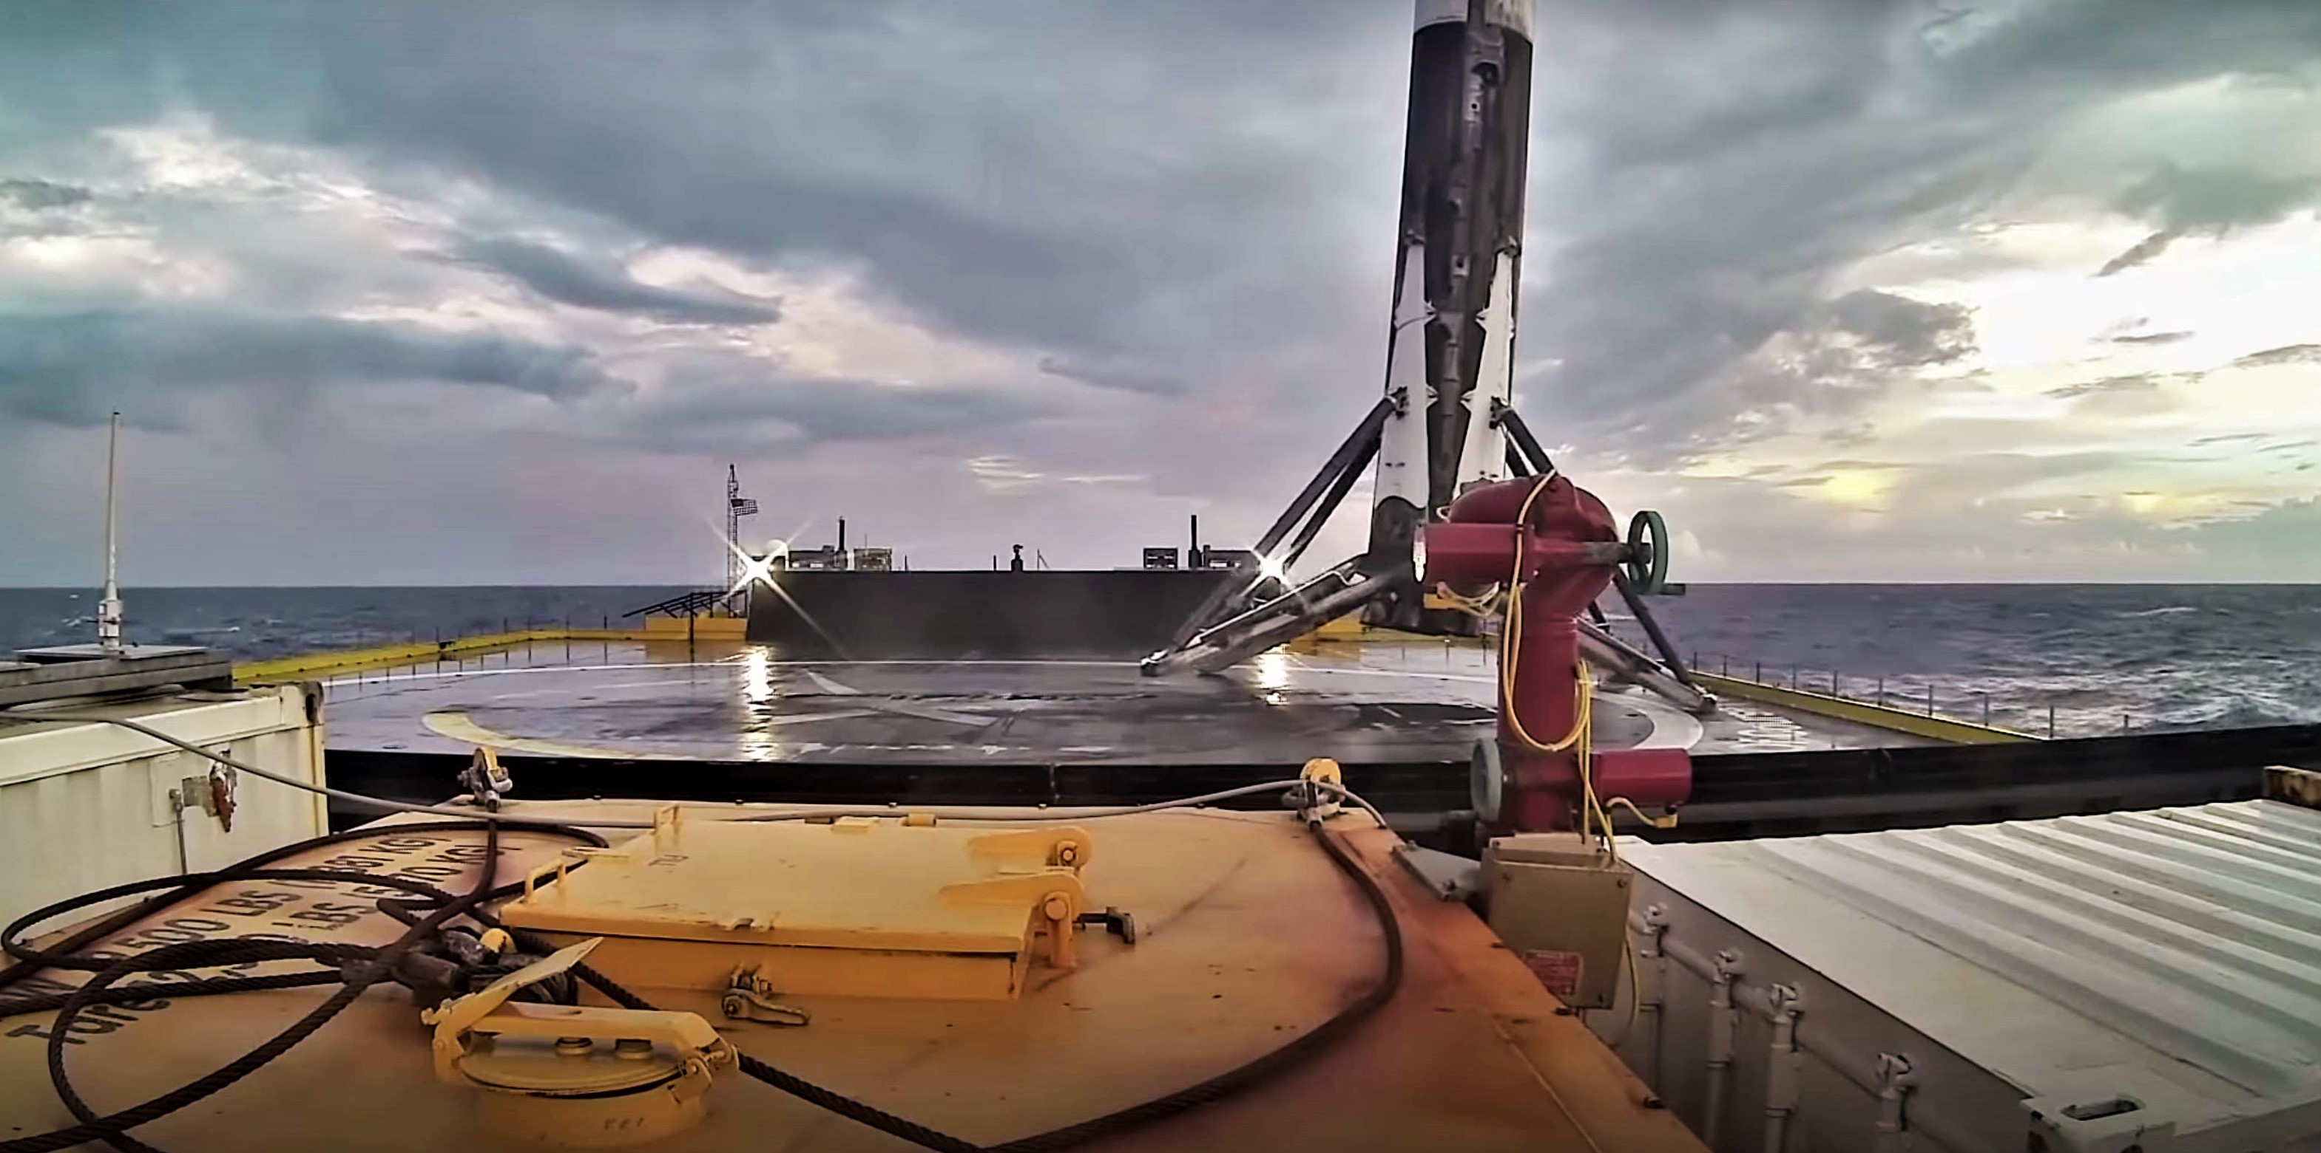
Motivation

Slide 3
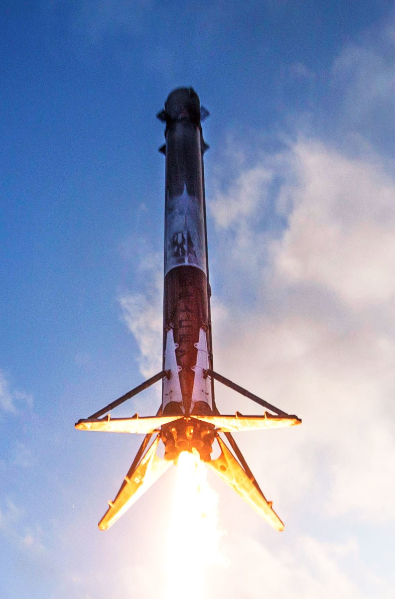
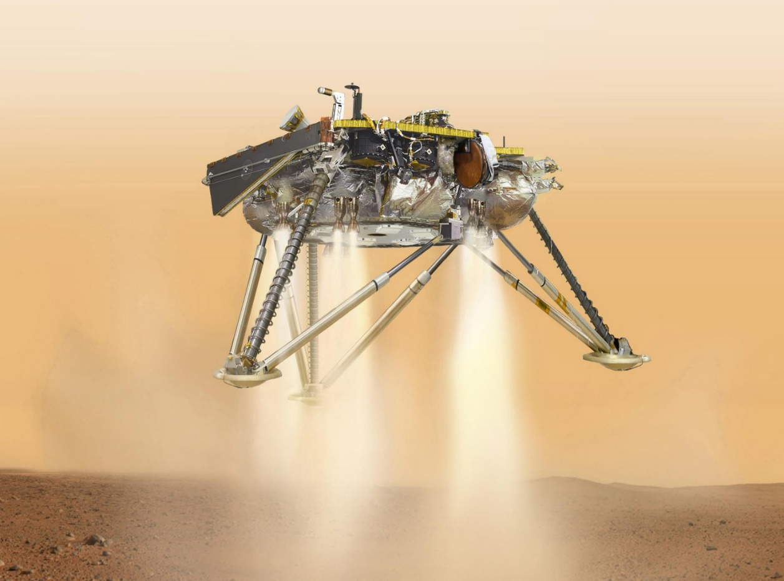
Motivation for Powered Descent Guidance
Answering: How do we landing something from space? Can we hit our target with precision?
Planetary Exploration and Reusable Launch Vehicles
Mars-to-Earth communication not possible for exploration landing maneuvers, meaning robust autonomy is required
Proposed Algorithms must be:
Computationally amenable
Dynamically feasible and have constraint satisfaction
Good off-nominal recovery and FDIR
Sense of optimality: maximize divert capability
Good dispersed and sensitivity performance
Image Credit: SpaceX, NASA

Slide 4
Other PDG and Solution Methods
Polynomial Guidance: not fully dynamically feasible, but computationally minimal, (Apollo and MSL - modified)
Bilinear Tangent and Powered Explicit Guidance: solved backwards, control solution form is assumed means some loss of optimality, simple
Lossless Convexification: excellent for 3DoF problem with linear dynamics, but not all non-convexities can be losslessly convexified (G-FOLD)
SQP and other NL Programs: computationally intense and no deterministic convergence criteria, highly dependent upon initial reference values
Successive Convexification (SCvx): satisfies all NL dynamics and non-convex constraints, deterministic convergence, computationally feasible: demonstrated at 8Hz (UW ACL)
Notes:
Polynomial: for retargeting and manual flight by astronauts, boundary state constraints and a fixed time-to-go to find closed-form solutions for acceleration profile, not guaranteed to satisfy vehicle thrust constraints, not optimal with respect to time or fuel consumption, all safely touched down on the lunar surface through the combination of astronaut control and the polynomial guidance routine
MSL: used modified linear time search for time to go, still does not result in globally optimal trajectories, no divert capability
Also Pseudospectral collocation

Slide 5
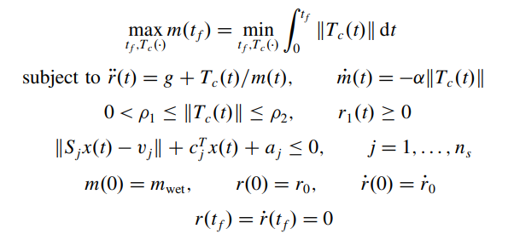
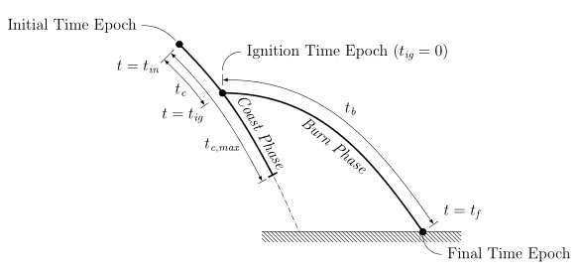
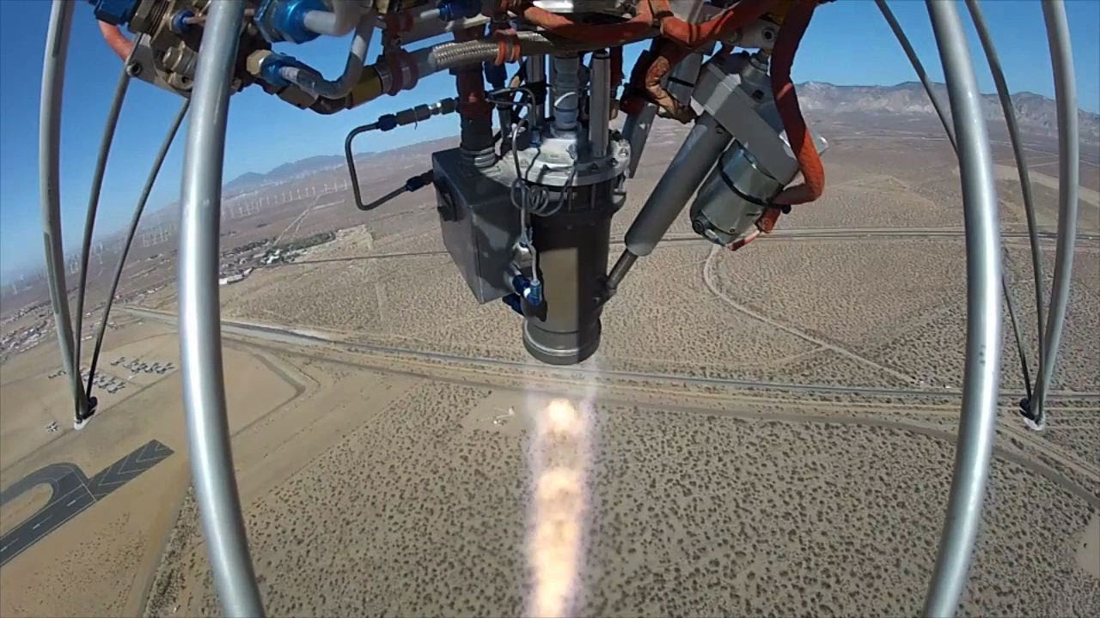
Simplest Problem Description
Basic 3DoF problem in the surface fixed frame, assuming constant gravitational field, and constrained actuator
Objective is to minimize fuel use
Solved: Lossless Convexification + outer time-of-flight search via linear program
Minimum thrust constraint is non-convex
Assumes bandwidth of ACS has much higher bandwidth than translational control authority
Solved exactly with Lossless Convexification, tested online and in-flight: promising for future of planetary landing
Image Credit: M. Szmuk, Masten Space Systems
Notes:
Most people thing about the Blackmore, Acikmese, Carson solution called GFOLD

Slide 6
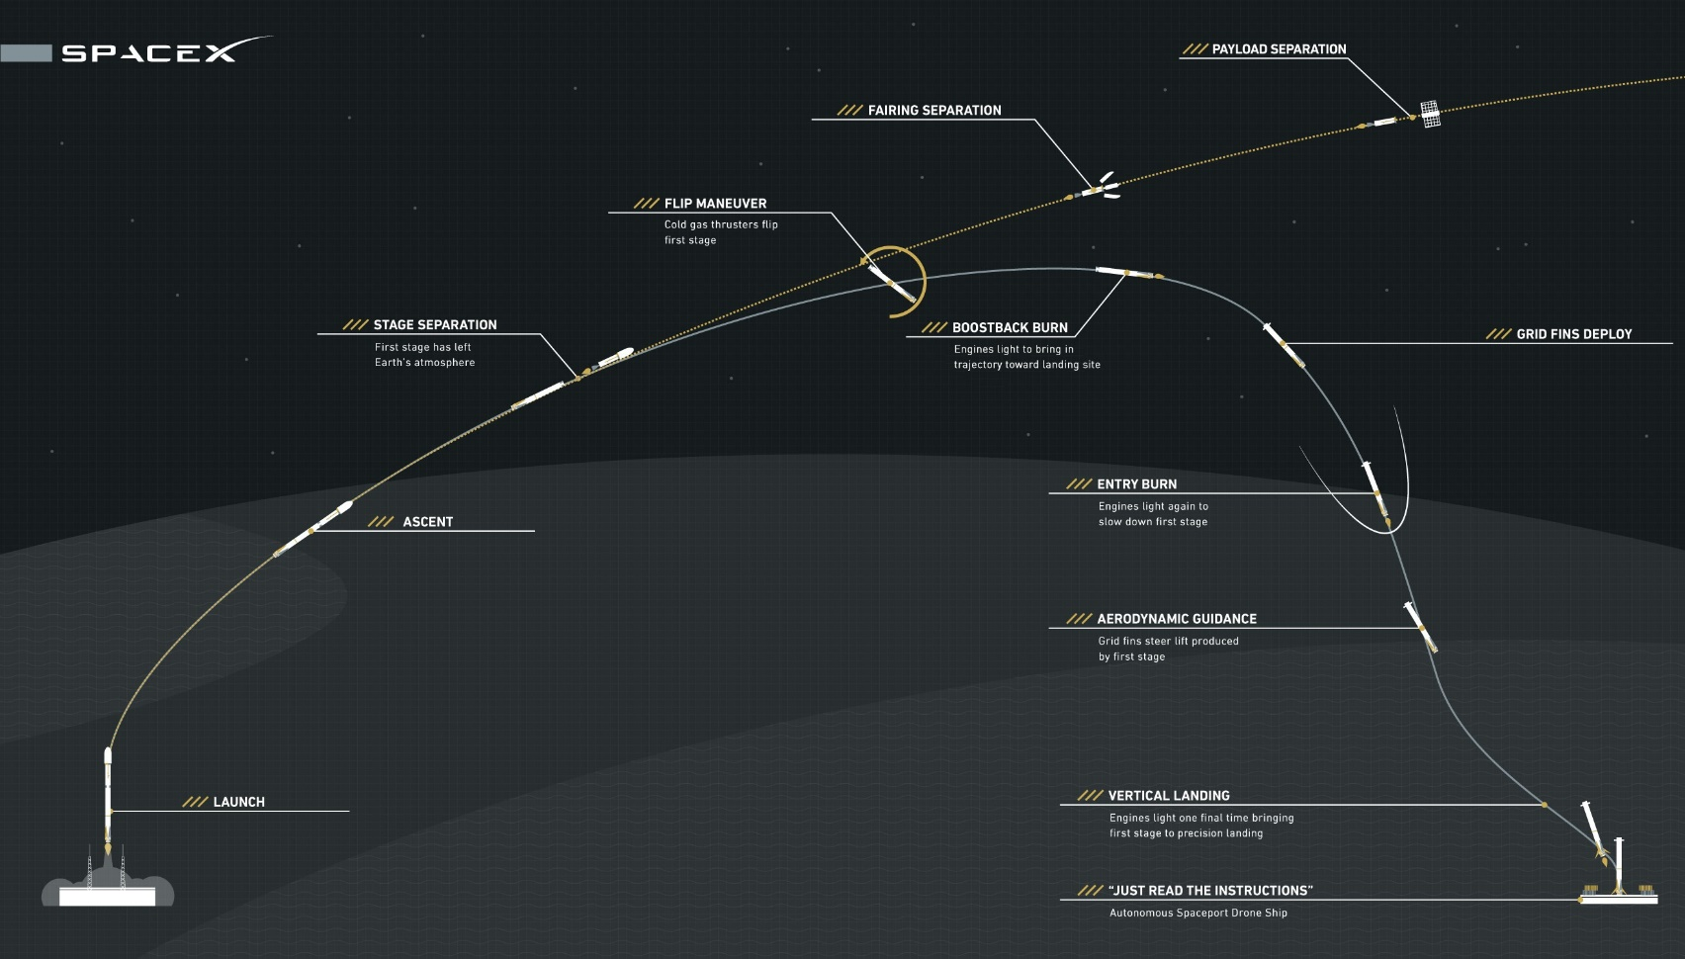
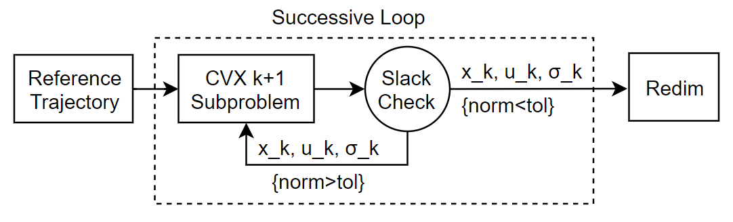
A 6DoF Powered Descent Guidance Approach
Research question: how to form a sequential optimal guidance algorithm, informed by all NL dynamics and actuator constraints?
Modified implementation of Szmuk/Açikmeşe 2018 in CVXpy – ECOS solver
Sequential algorithm, factoring full nonlinear dynamics, full-state reference trajectories
Applied to pin-point landing for VTVL’s with throttleable engine, TWRs > 1
Amenable to online implementation and a powerful offline tool
Image Credit: SpaceX

Slide 7
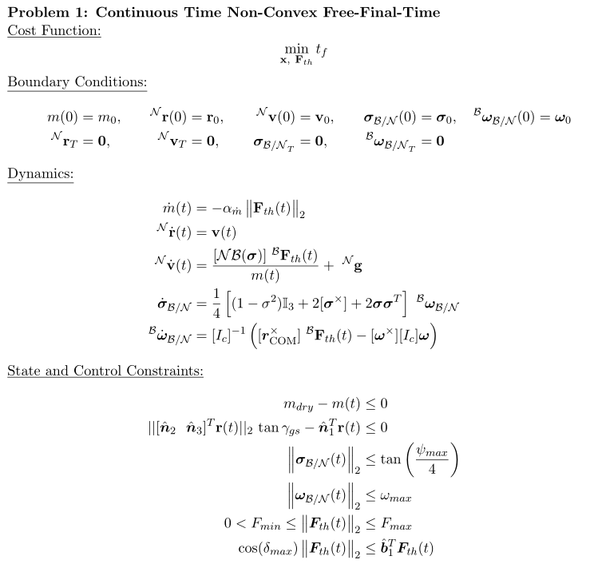
6DoF Continuous Free-Final-Time Problem Description
Objective: minimize the final time of the burn sequence
With hard initial and terminal condition constraints
Follow the 6DoF nonlinear dynamics closely
Subject to state and control constraints
Using constrained MRP allows for quicker solve times than quaternions, fewer variables

Slide 8
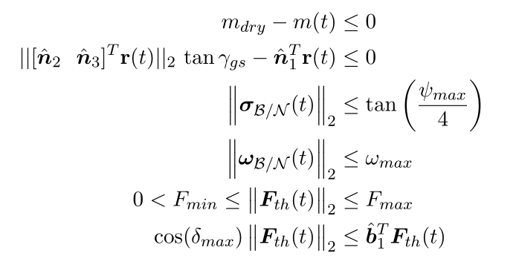
State and Control Inequality Constraints
Never run out of fuel
Always be within glideslope of the terminal point (ensures no ground collisions as well)
Constrain your total alignment with normal of surface plane
Don’t spin unreasonably
Rocket engines only work well within a dynamic range [min, max]
Non-convex region
Restrict the deflection range of the thrust vector control gimbal

Slide 9
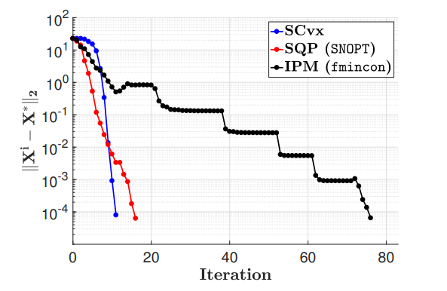
SCvx: A Superlinearly Convergent Algorithm for Non-convex Optimal Control Problems
SCvx iteratively solves convex sub-problems obtained by linearizing non-convexities in dynamics and constraints around the previous iteration solution
It’s an ‘SCP’ type algorithm that uses virtual control, buffer zones, and trust regions
Credit: Y. Mao et al., 2019
Not indicative of solution time
Simplified block diagram used in my implementation. For full SCvx algorithm see {Y. Mao et al., 2019}

Slide 10
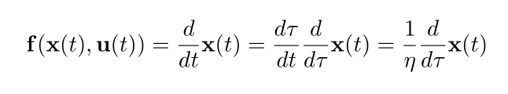
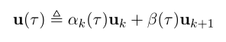
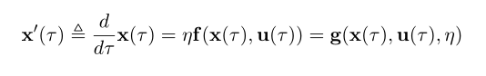
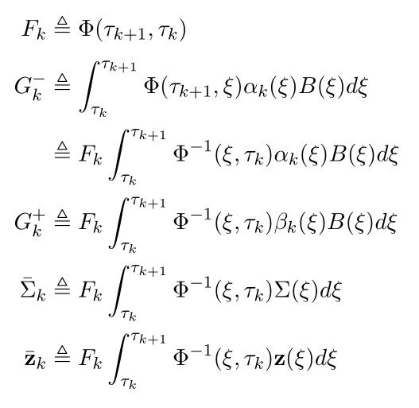
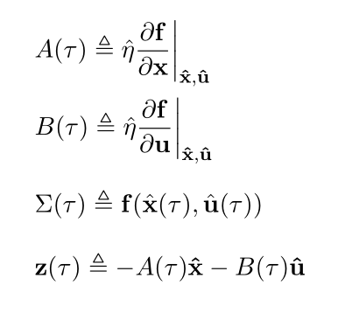
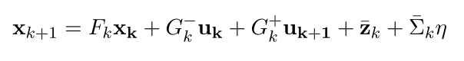
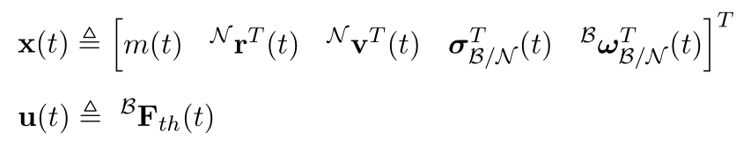
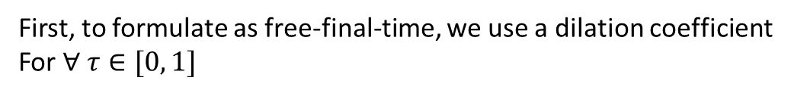
Discretization and Convexification – First Order Hold
First, to formulate as free-final-time, we use a dilation coefficient
For $∀ τ∈[0, 1]$
Discretize, form control problem as a FOH solution of form:
Linearizing:

Slide 11
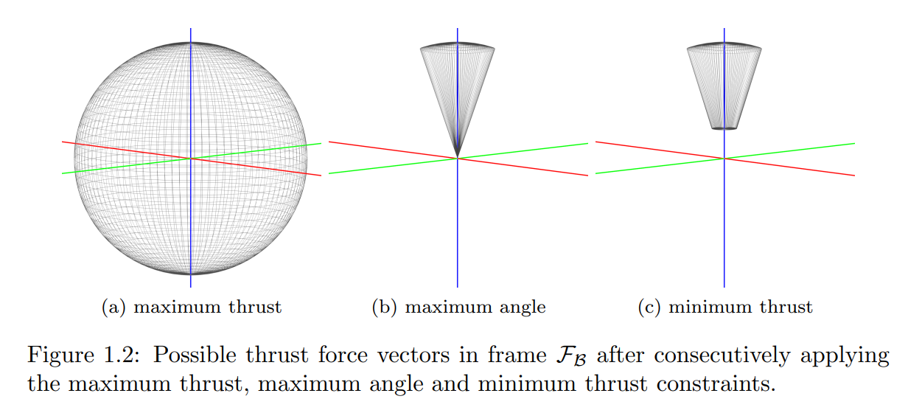
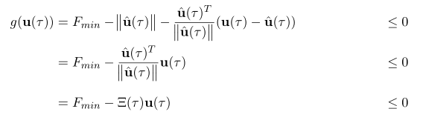
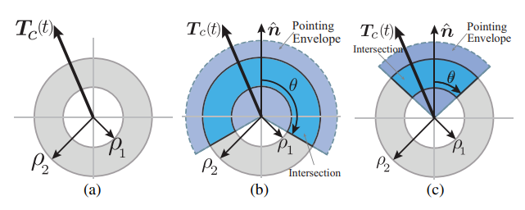
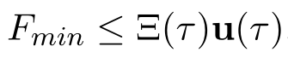
Control Constraint Convexification
Lossless Convexification takes care of this by introducing slack variables
SCvx takes care of this via linearizing about the previous input history:
Image Credit: S. Niederberger, L. Blackmore et al.

Slide 12
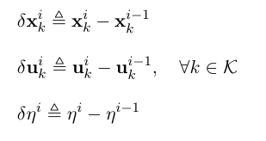
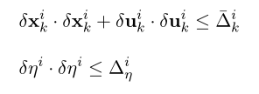
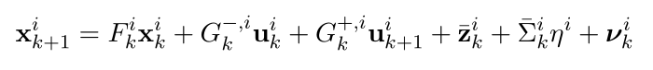
Trust Regions and Virtual Control Dynamic Relaxation
Soft trust regions are employed to prevent dynamic artificial unboundedness
Ensure that from iteration i → i+1 the dynamics and control remain sufficiently close
Virtual control is employed to prevent dynamic artificial infeasibility
This allows linearizations about unrealistic conditions to still produce a solution for that iteration (right-superscript i), making the dynamics:
We augment the cost function such that these are minimized
Which form the constraints

Slide 13
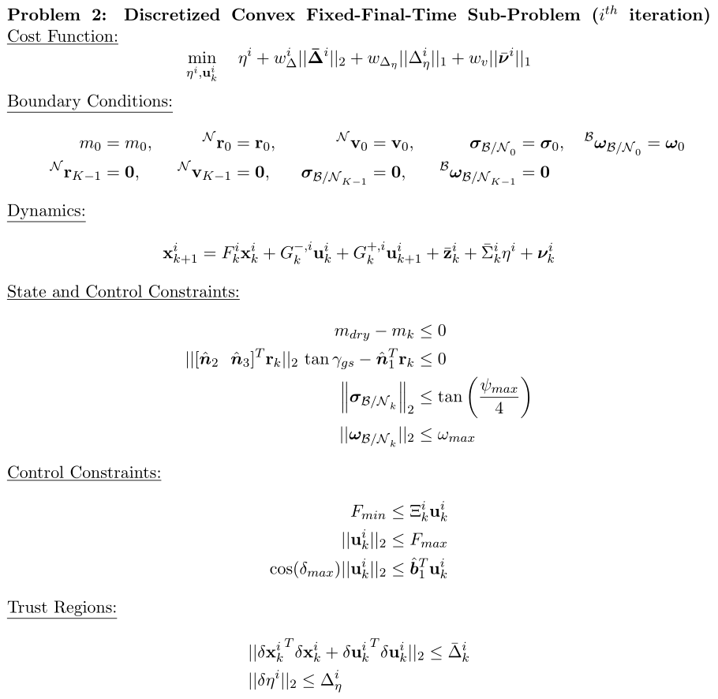
Fixed-Final-Time Convex Sub-Problem
We now have a discrete linear-time-varying individual sub-problem
This is solved successively to make it free-final-time and to minimize virtual control and trust region magnitudes below dynamic-feasibility tolerances

Slide 14
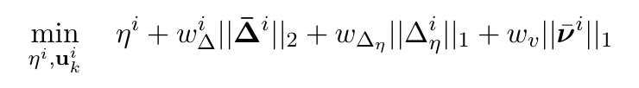
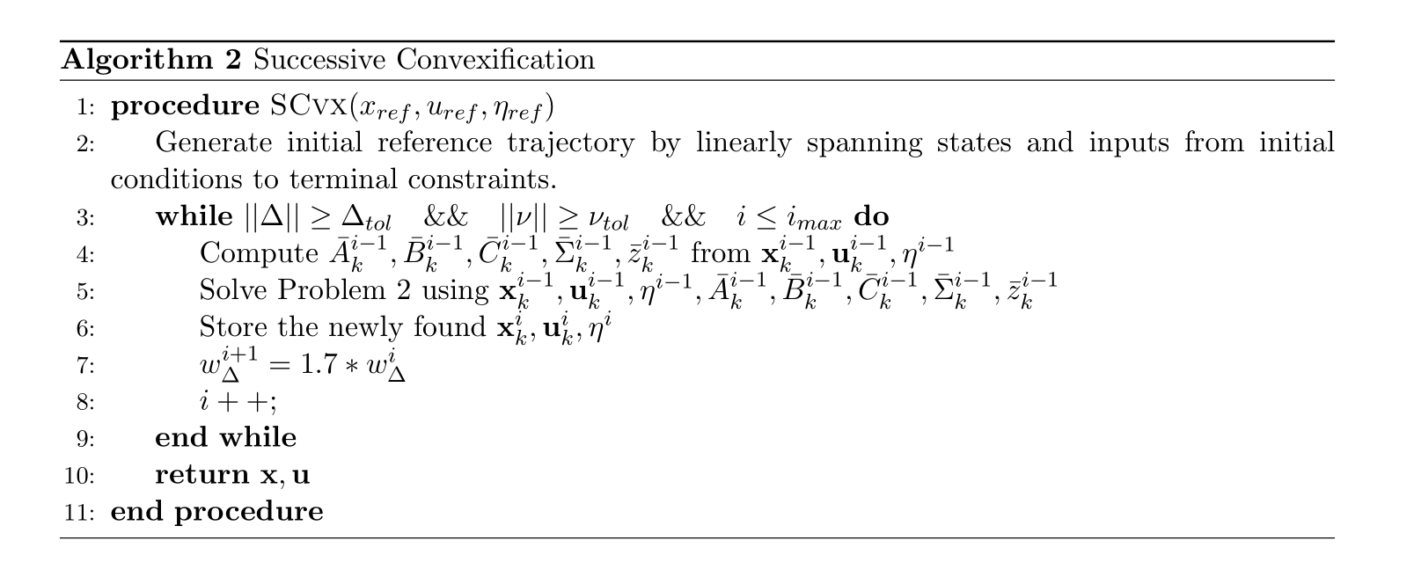
Successive Mechanism
Modified and simplified version of the full proposed SCvx structure (Y. Mao et al. 2019)
Recall the sub-problem to be:
Dynamics are non-dimensionalized for numerical stability

Slide 15
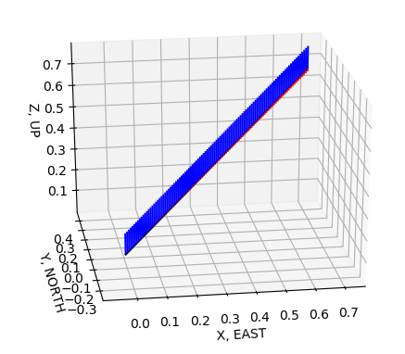
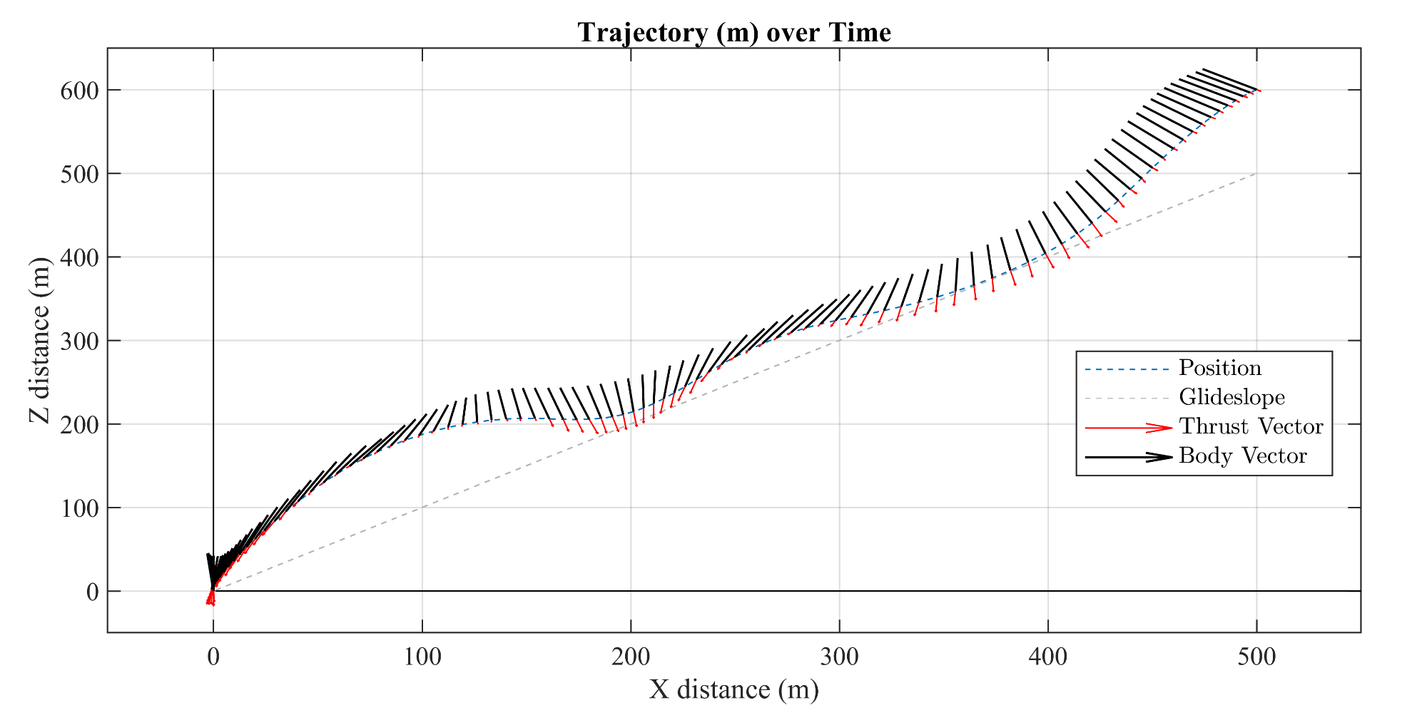
Algorithm Initialization
Dynamically feasible and constraint-valid trajectories not required
Cold-starts still have excellent performance (~400ms on un-optimized platform)
Better reference trajectories do speed up convergence process
15 SCvx Iterations later

Slide 16
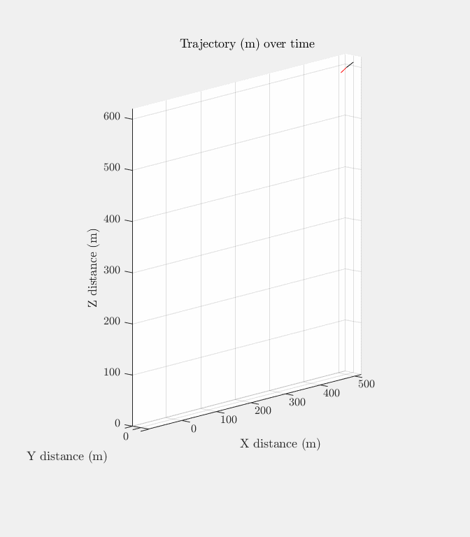
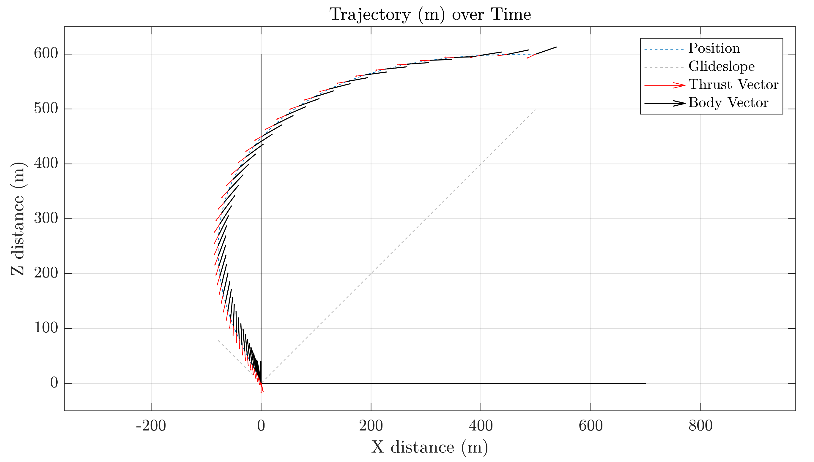
Planar Landing Prototype Example
Dimensionalized properties: Masten Space Xombie Vehicle.
Assuming an Earth Landing
Successful recover from pitched-over initial condition
Notes:
Just make sure your constraints have the right actuator values

Slide 17
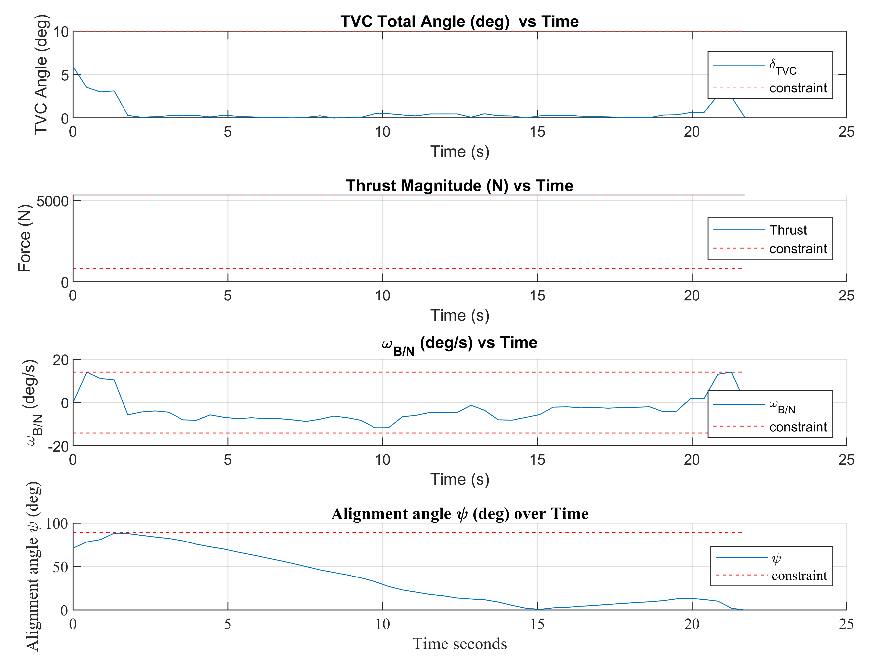
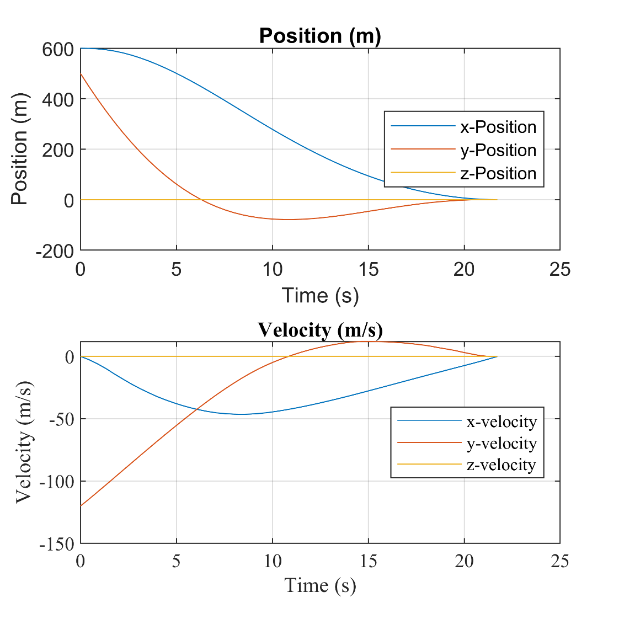
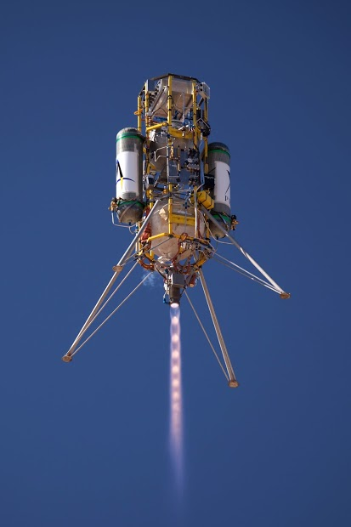
State and Control Constraint Satisfaction
All state and control constraints met
Note maximum thrust for the full duration, and TVC throttling to meet other requirements
Terminal position and velocities met exactly
R_o = [600, 500, 0] m, V_o = [0, -120, 0] m/s
Image Credit: Masten Space Systems

Slide 18
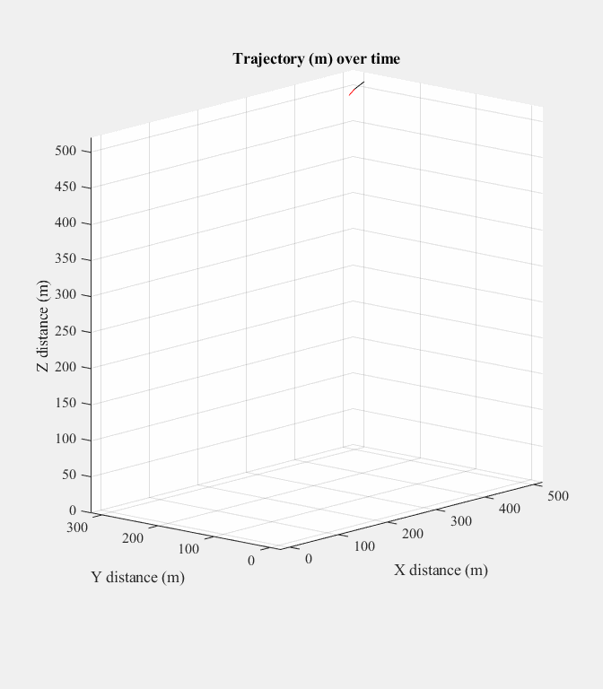
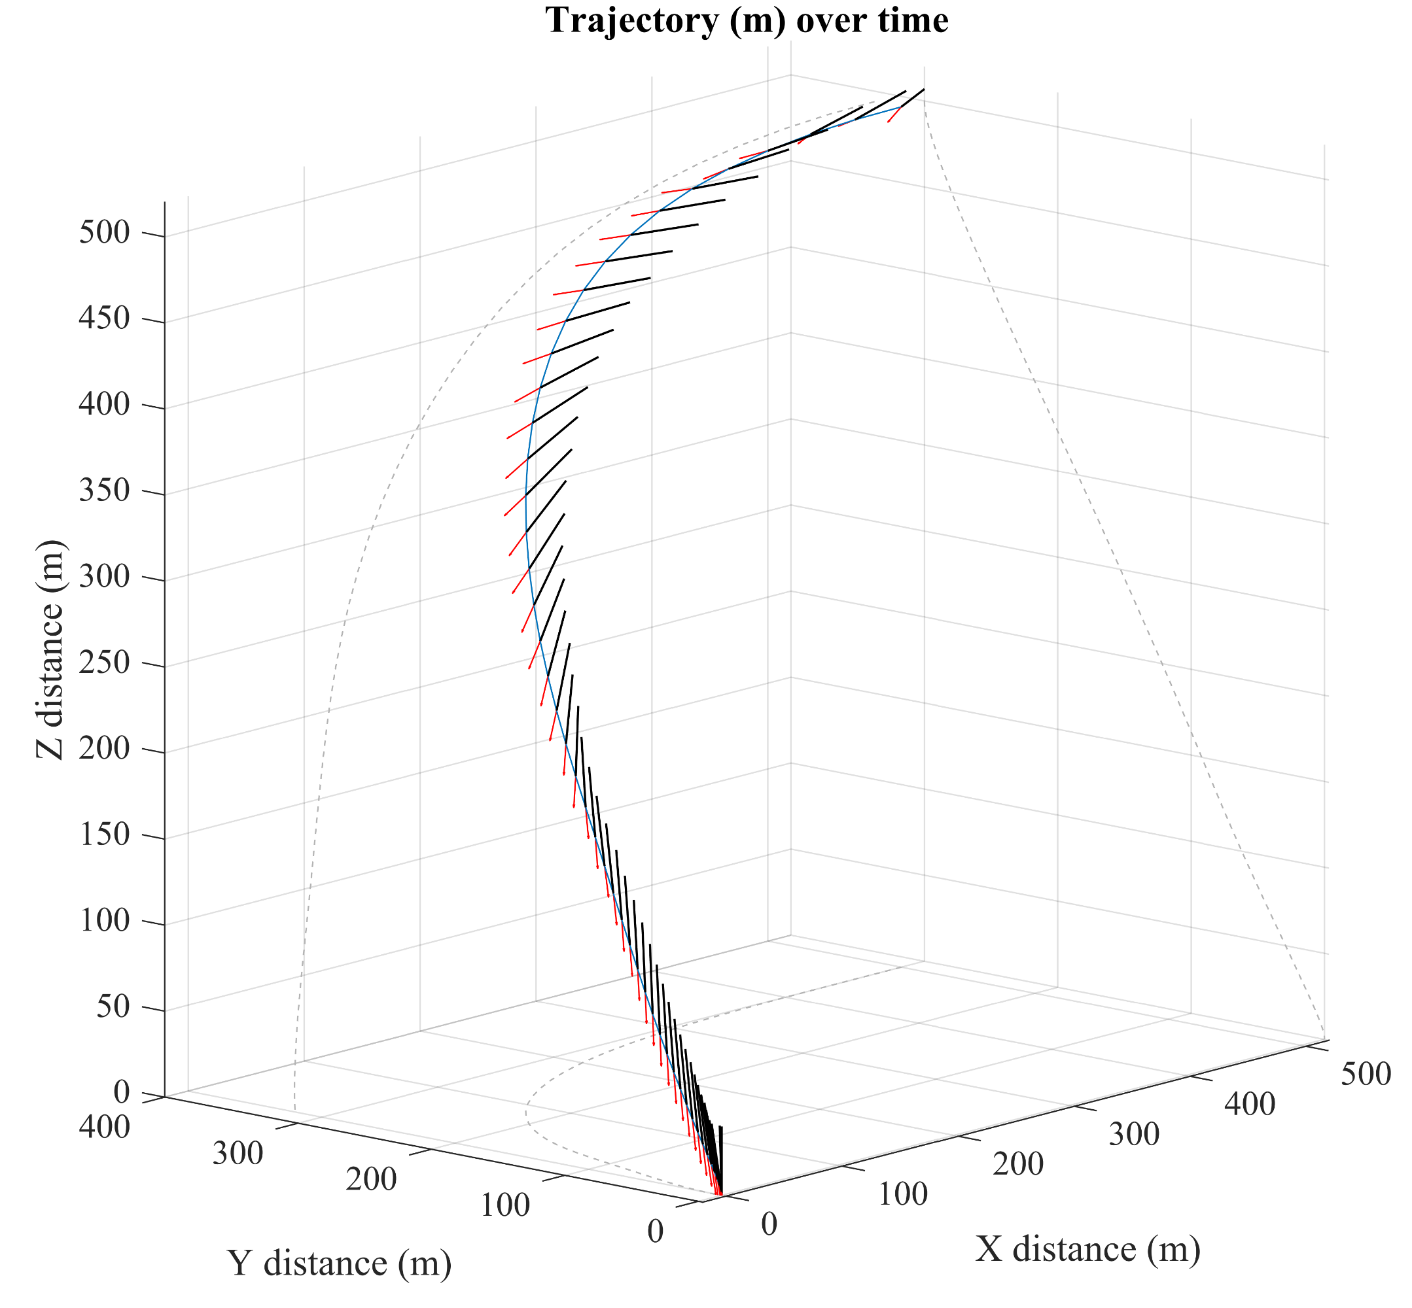
Large Non-Planar Diverts
Guidance result for Masten vehicle Earth landing with off axis initial condition

Slide 19
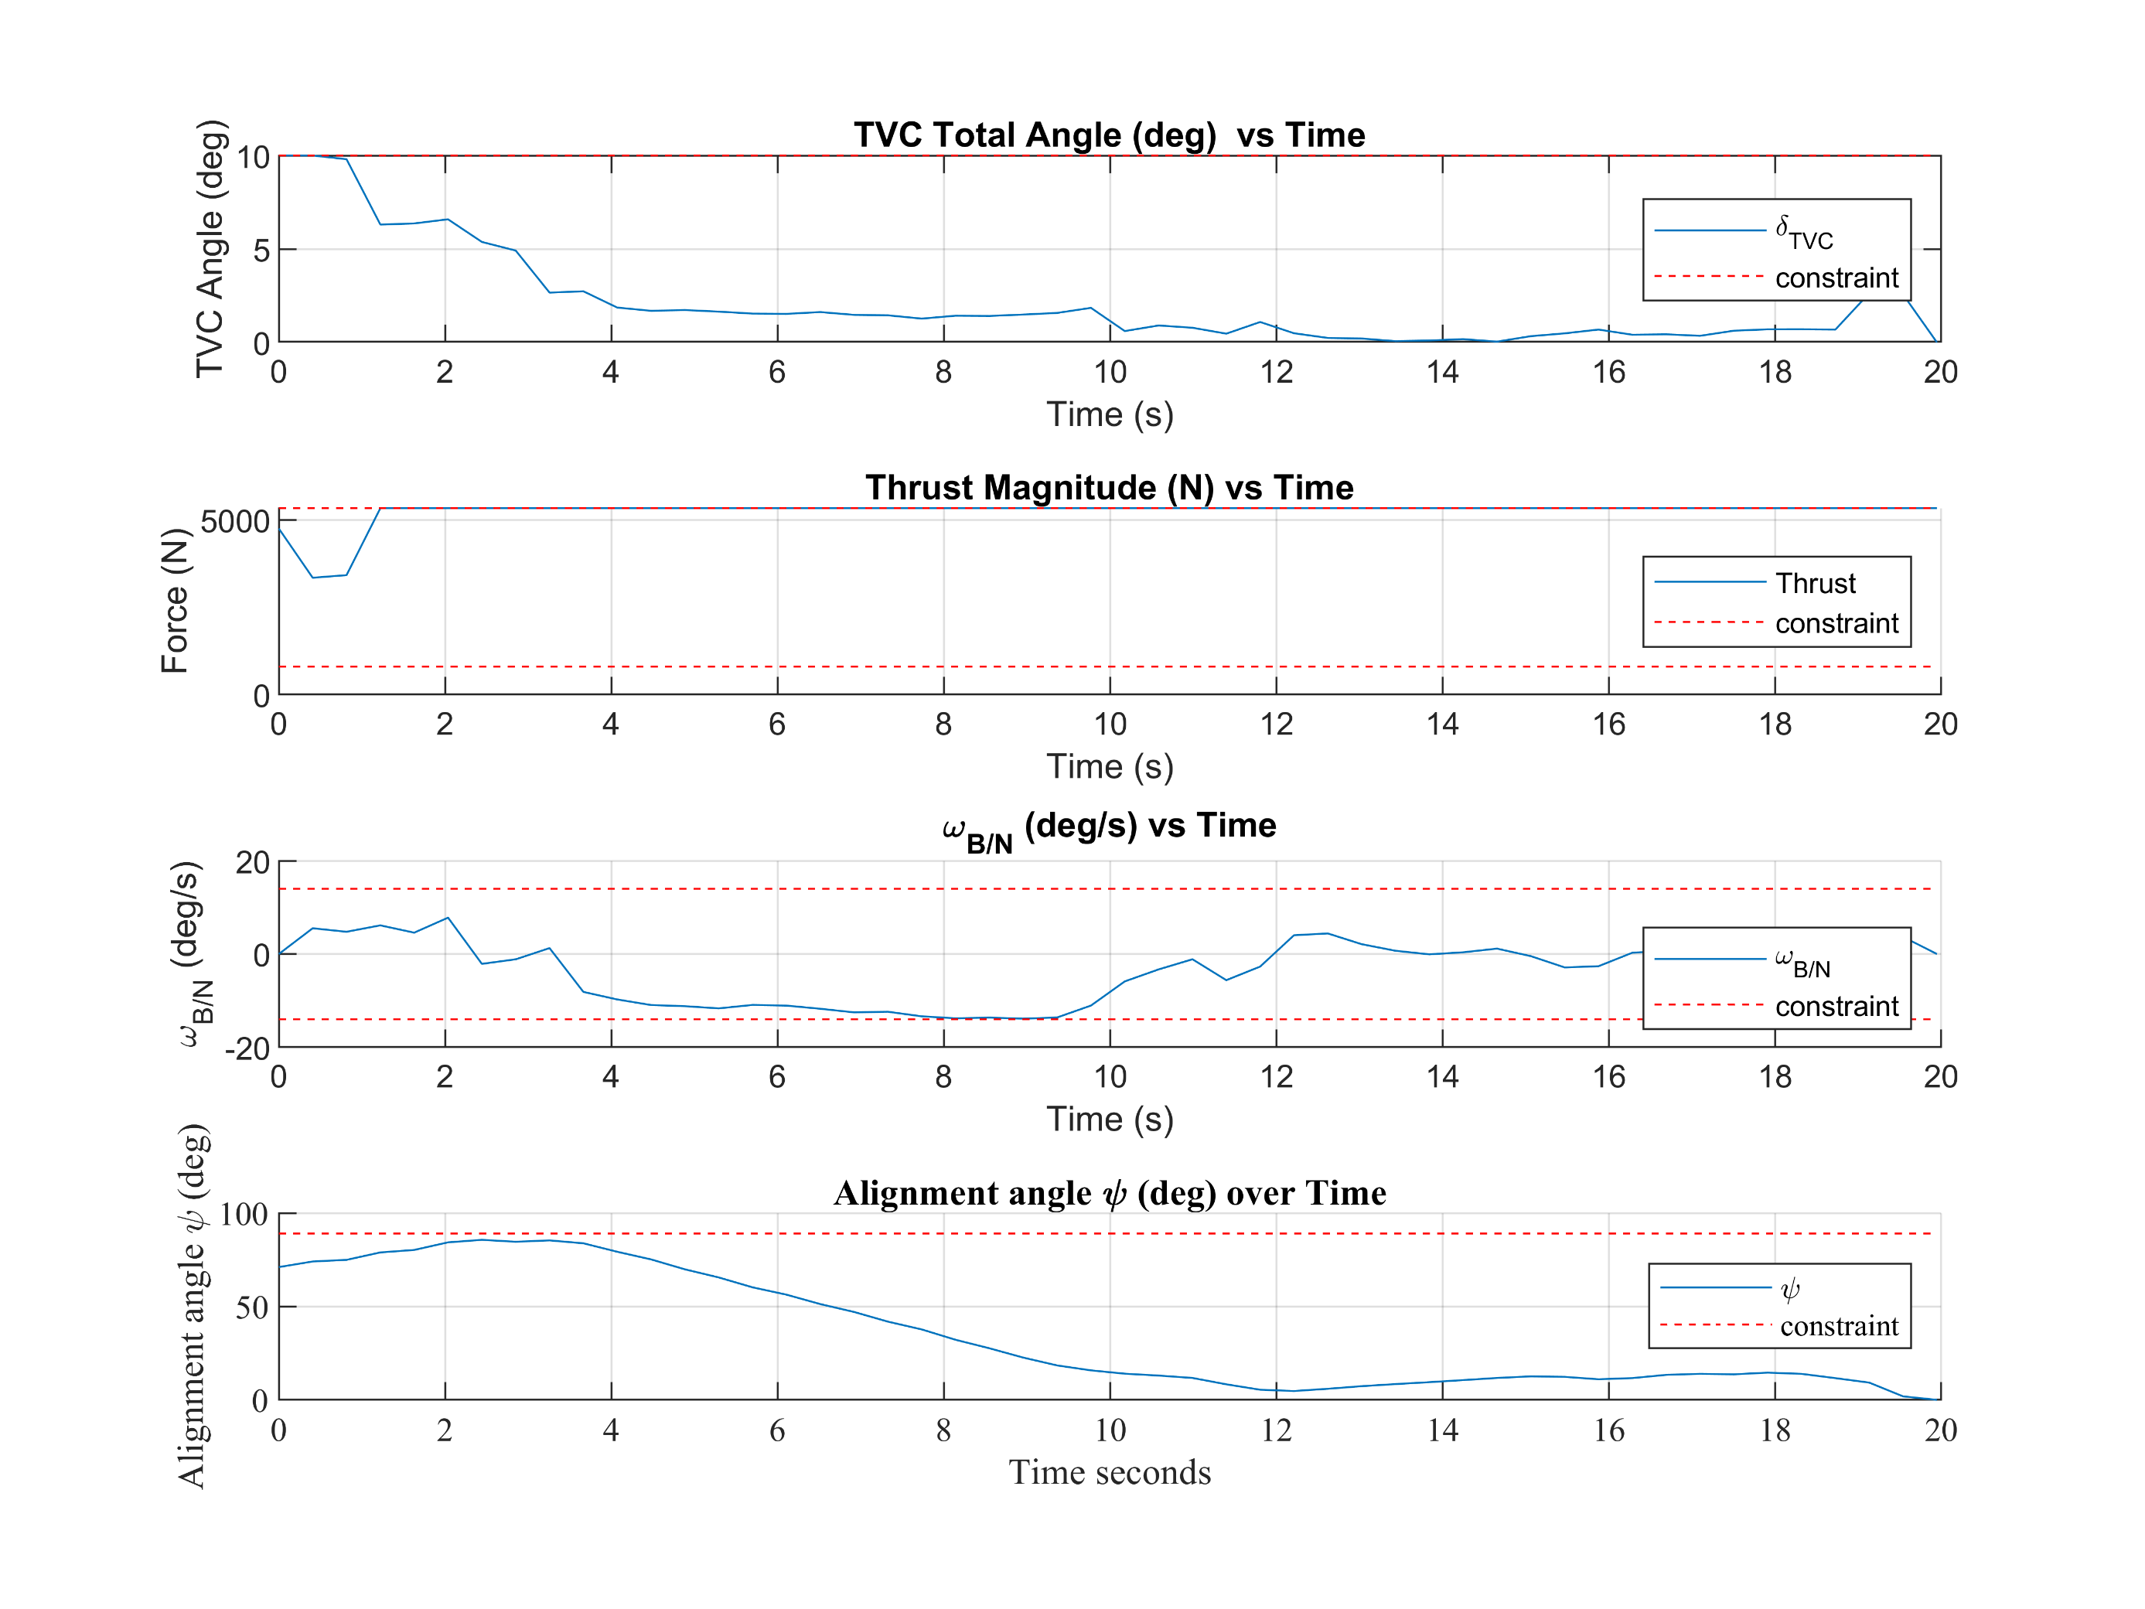
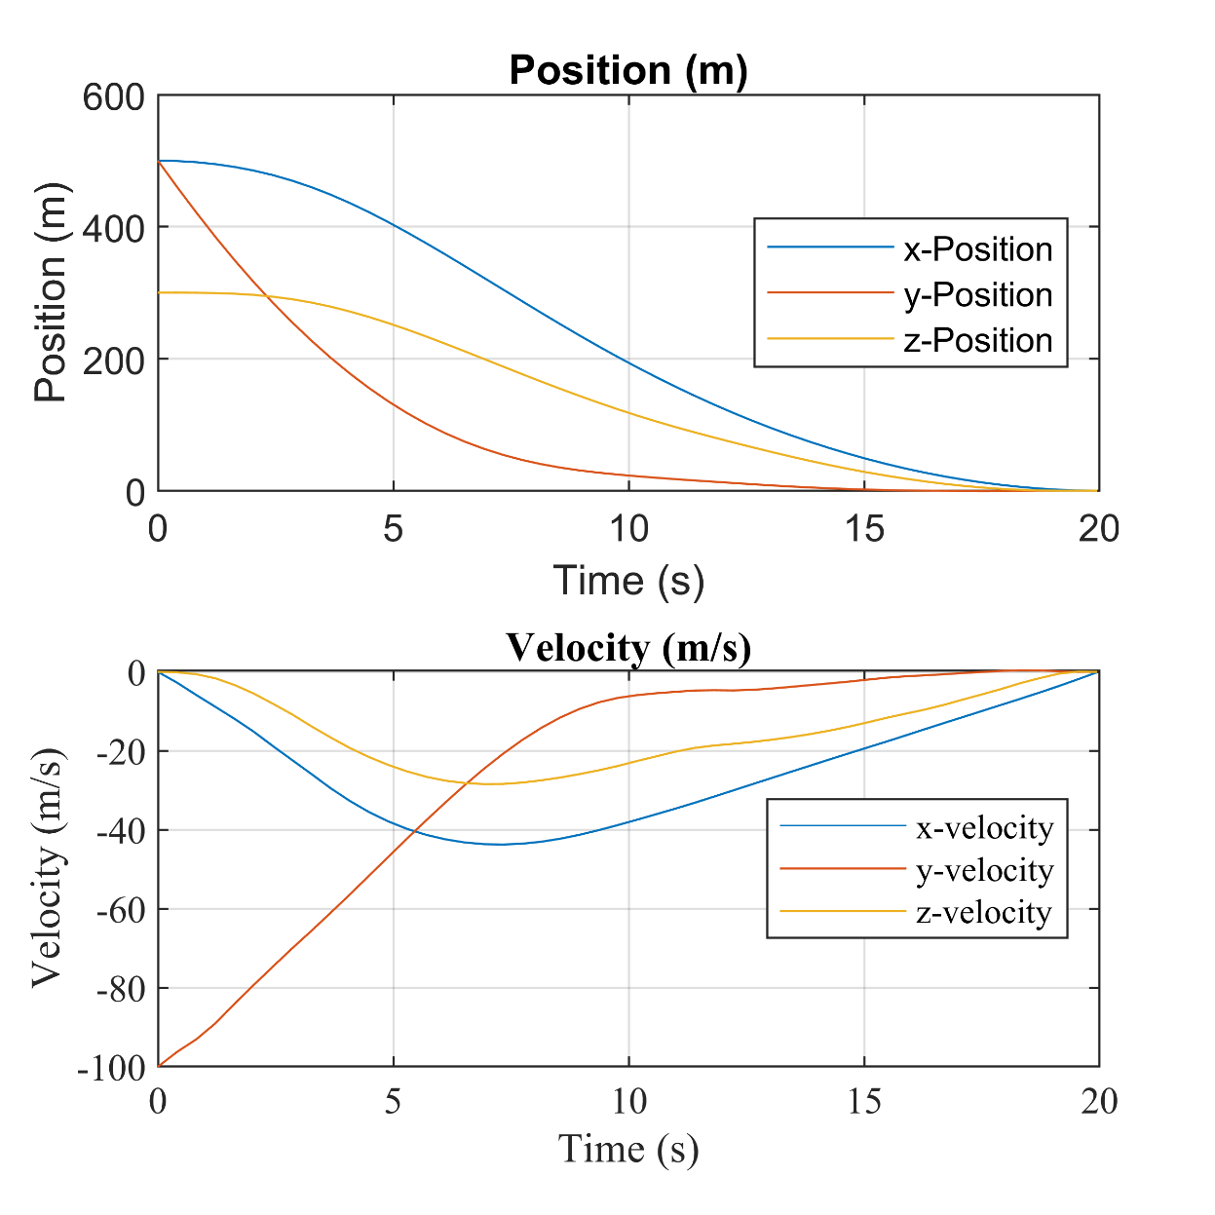
State and Control Constraint Satisfaction
All state and control constraints met
Most of pitch-over is done at the beginning with maximum TVC angle used
Terminal states met exactly
R_o = [500, 500, 300] m, V_o = [0, -100, 0] m/s

Slide 20
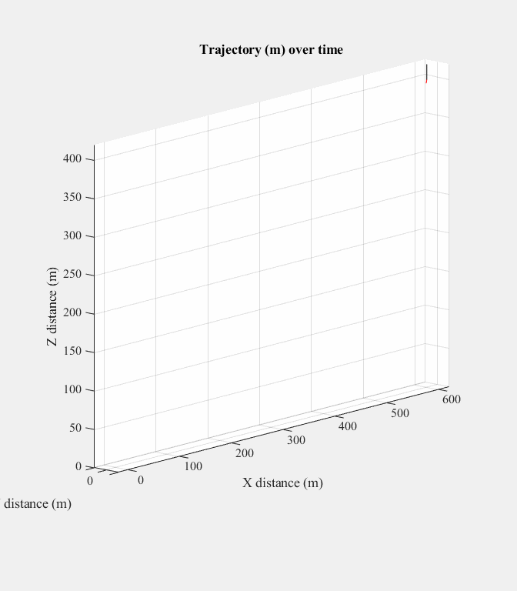
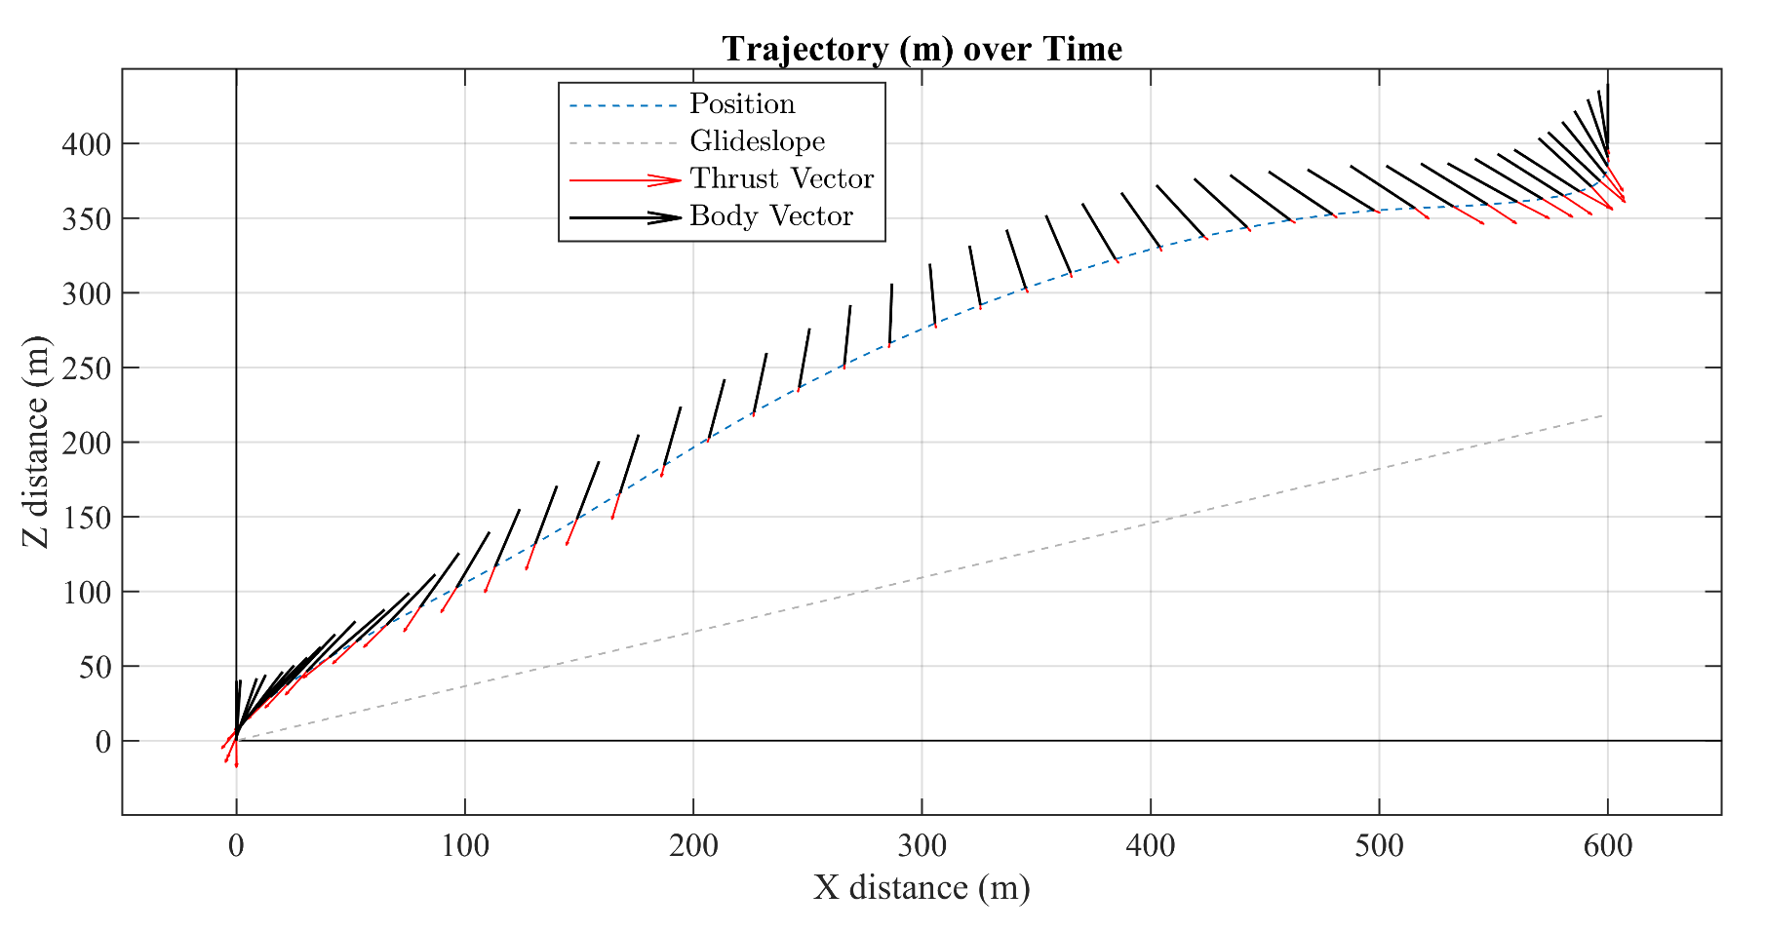
Fuel-Optimal Large Diverts
Bang-Low-Bang Solution visible
Dimensionalized properties: Masten Space Xombie Vehicle.
Assuming an Earth Landing
Successful recover from off-nominal initial condition

Slide 21
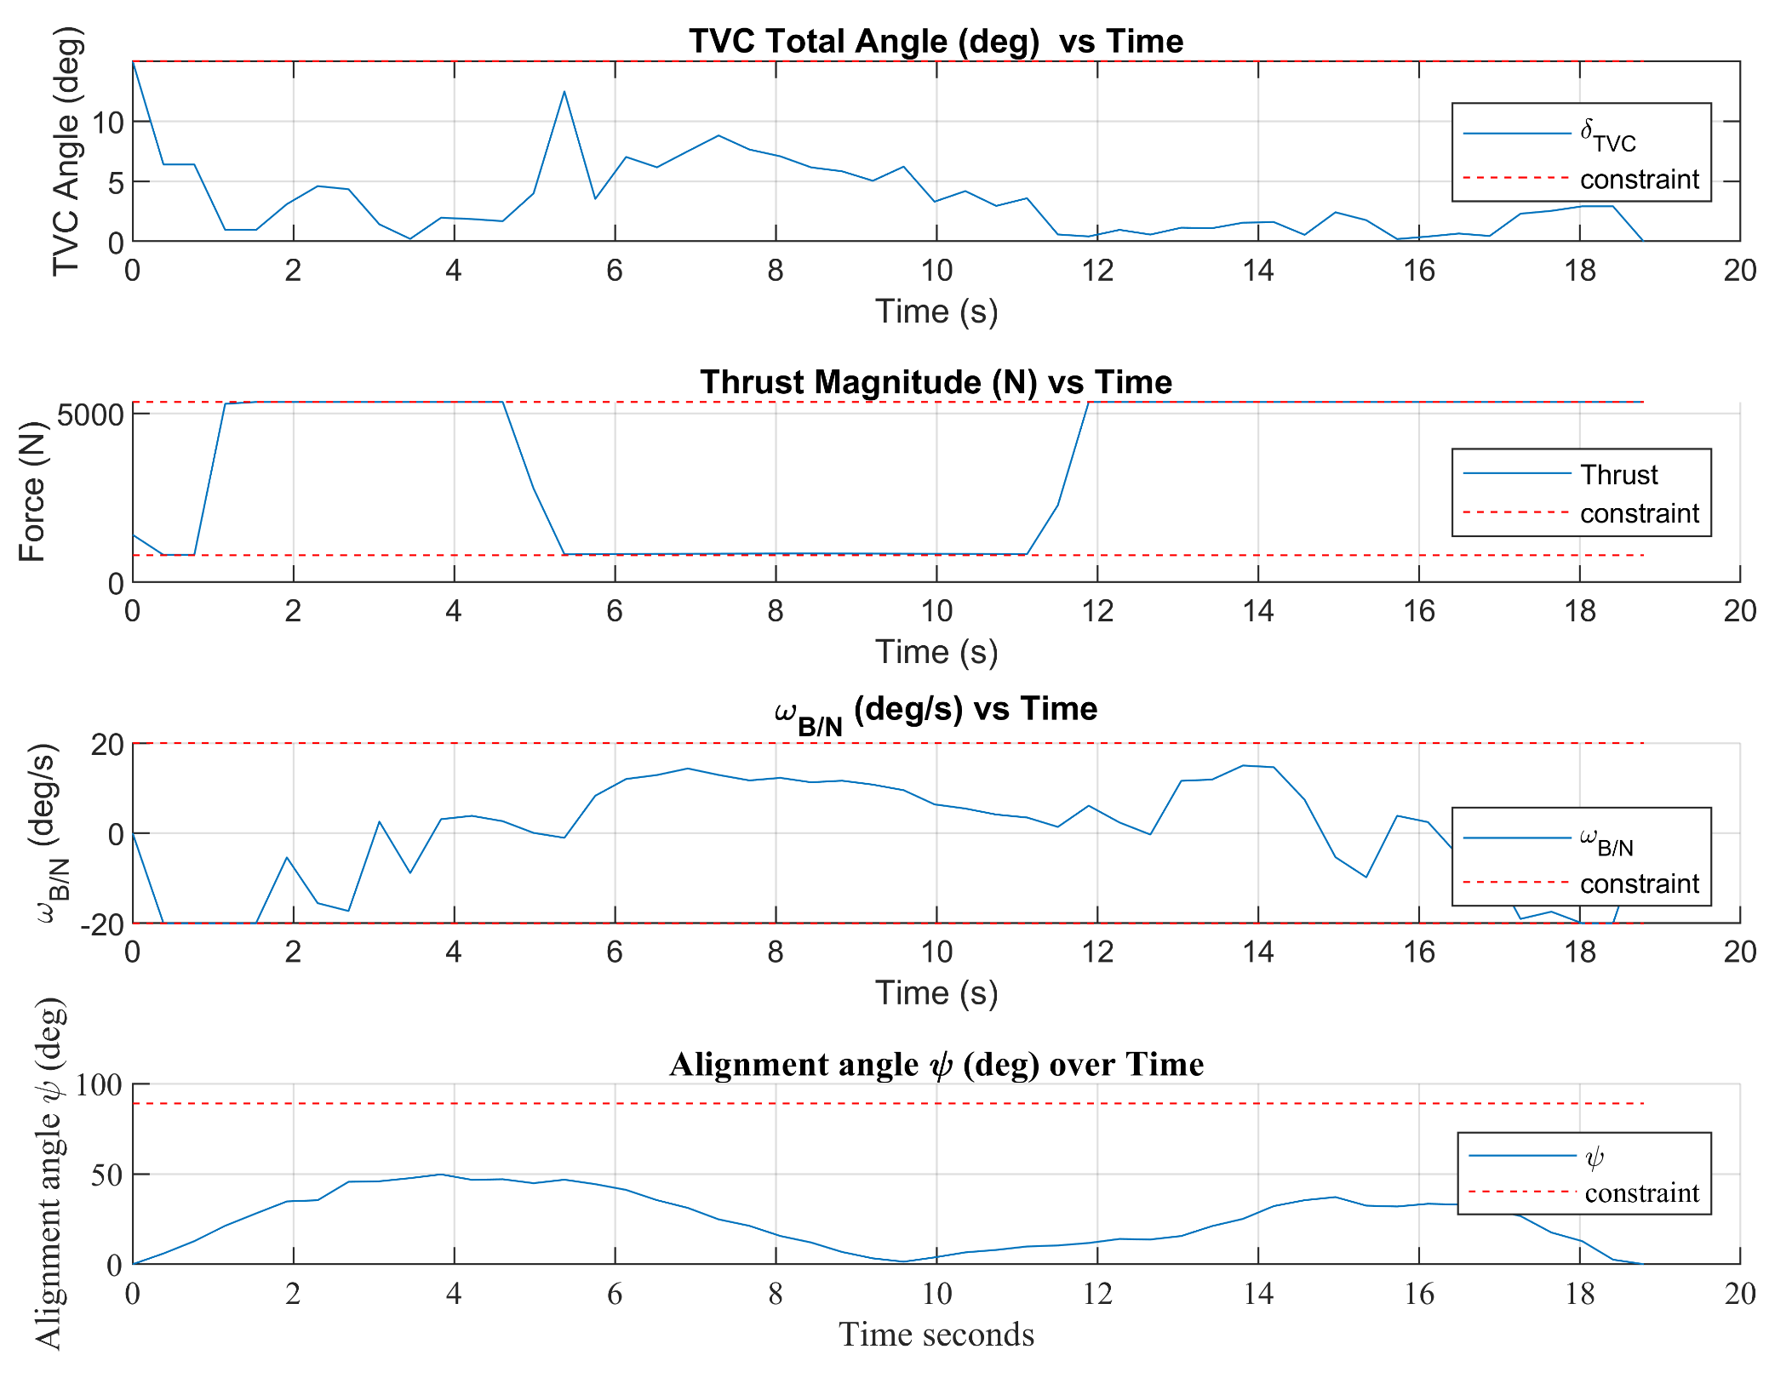
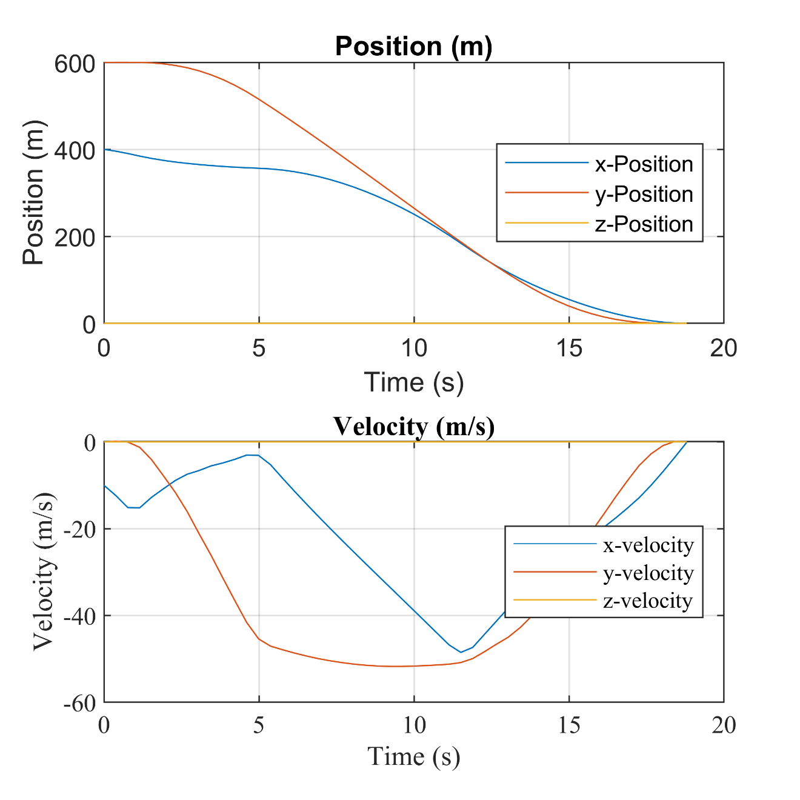
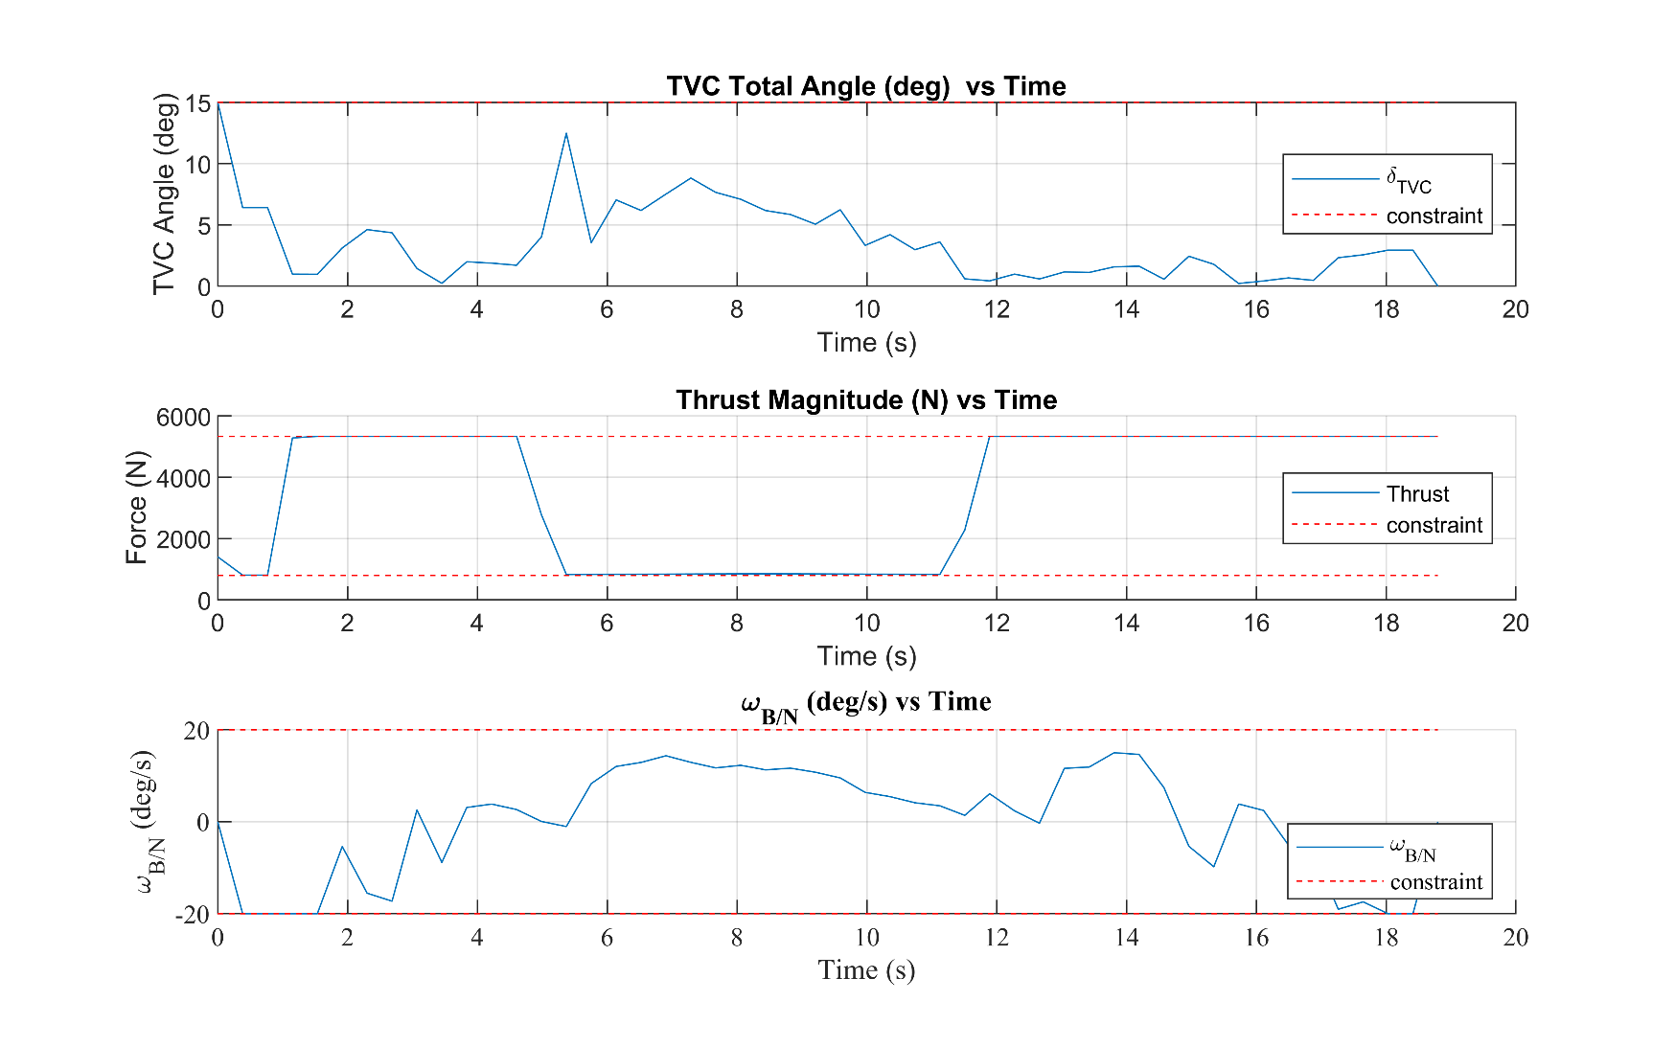
State and Control Constraint Satisfaction
All state and control constraints met
Note maximum thrust for the full duration, and TVC throttling to meet other requirements
Terminal position and velocities met exactly
R_o = [400, 600, 0] m, V_o = [-10, 0, 0] m/s
Image Credit: Masten Space Systems

Slide 22
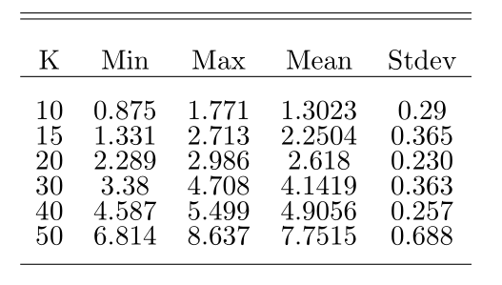
Timing Study
For prototype example
Run-Time on Intel i7-7700HQ, 2.8GHz, 16GB RAM, runs on single thread
Speedup:
Parallelized processing
Customized Solvers
C/C++ implementation
Dedicated compute or Prioritized Tasking
ACL’s dedicated system for drones
7 to 8Hz (D. Dueri solver)
Average time for K=10 case on 3.7GHz is 400ms

Slide 23
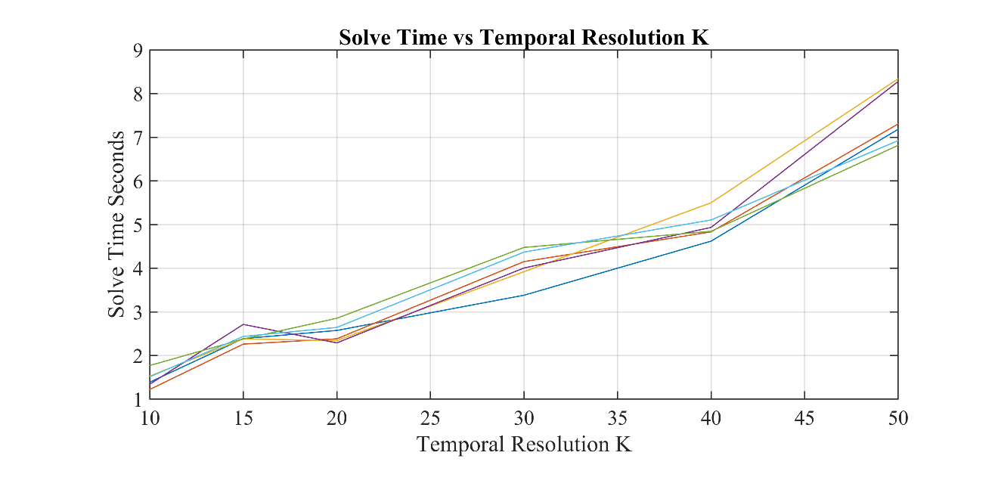
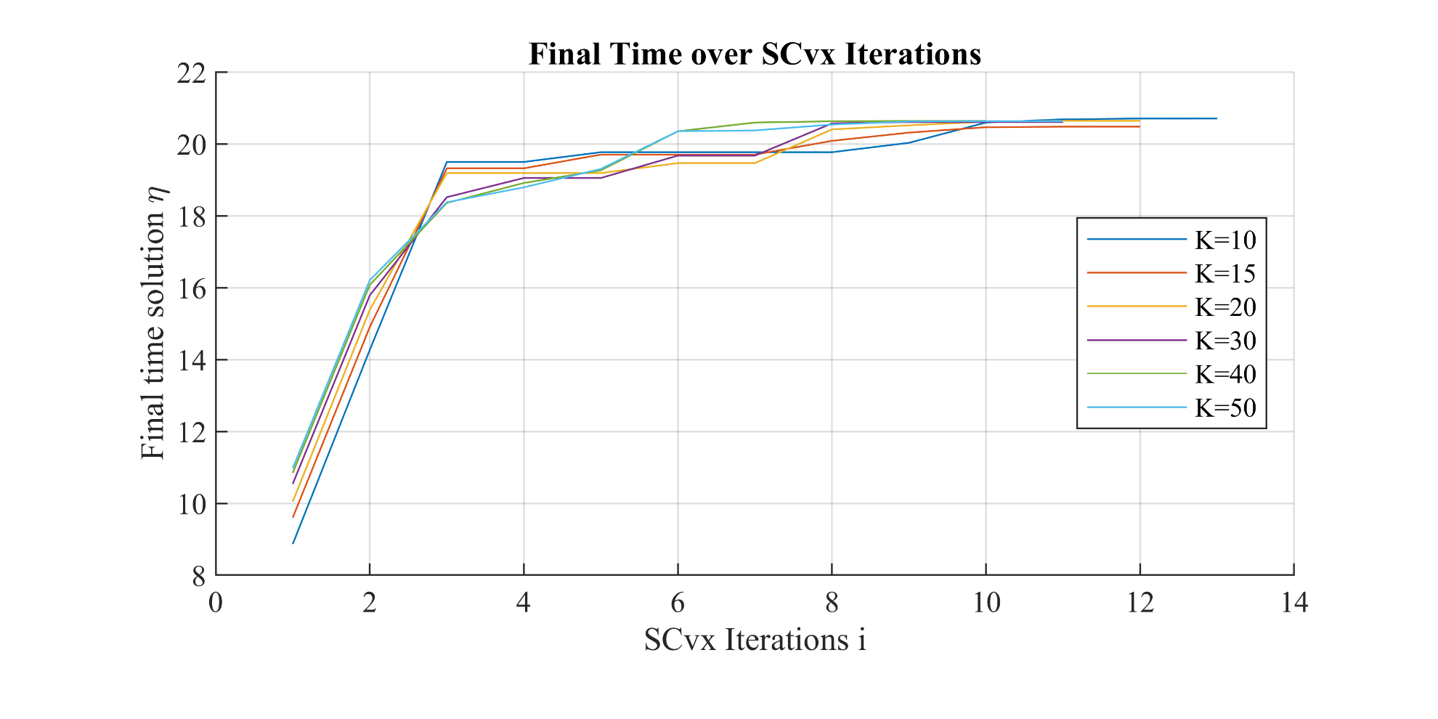
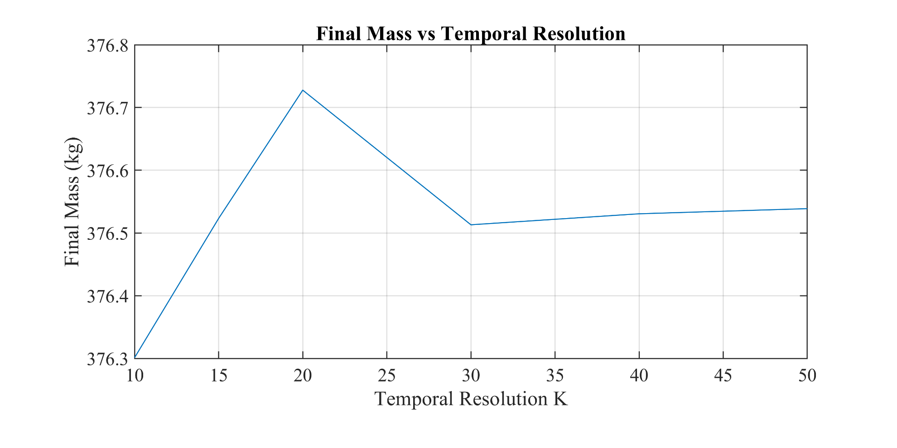
Timing Study
Problems that can be solved with fewer temporal nodes K, should be
Terminal mass does not change much for many problems, analysis should be done by engineer a priori
Final time convergence rate similar between K node runs

Slide 24
Conclusion and Future Work
The proposed algorithm solves the free-final-time, fuel-optimal, 6DoF pin-point powered descent guidance problem to the exact non-convex nonlinear dynamics and constraints.
This work applies modifications to work based on Szmuk et al. PDG algorithms
Highly Versatile
Single trajectory guidance
Receding horizon, sequential guidance
+ Feed-forward input and agile feedback laws (as per M. Szmuk)
Offline modeling tool, LUT trajectory generation, or for feasibility studies
Future work
Open-source a general C/C++ implementation of SCvx for MPC problems
Implementation of state triggered constraints (STCs) for hybrid event-triggered control problems like hypersonic entry – as a mission design tool
STCs for MRP switch, for nonlinear attitude MPC problems
Solve the ascent problem with wind perturbations

Slide 25


Acknowledgements
Thanks to my committee: Dr. Robert D. Braun, Dr. Jay McMahon, Dr. Hanspeter Schaub
The EsDL team, Dr. Miki Szmuk, Dr. Behçet Açikmeşe, and many more

Slide 26

Backup

Slide 27

Convex Optimization
Many optimizations are just special cases of this form, including least-squares and linear programming
If a problem can be identified or formulated as a convex problem, then it can be solved efficiently by convex solvers.

Slide 28


Okay fine, but can you implement this?
Goal: build a 60 second flight-time-capable landing testbed for GNC algorithm development
Keep it scrappy, but safe, budget <$12k
Doable by refurbishing repaired equipment, various internet sources
Flight representative dynamics, sensors, avionics, and actuators
Make the vehicle its own test-stand
Abstract guidance routines to 1GHz computer, with Nav and Control tasks performer quasi-real-time on 600MHz MCU
Active Budgets:
Monetary, propulsion and feed, power, and communications

Slide 29





Avionics – Flight Computer and Sensors

Slide 30




Propulsion System
Pressure-fed 450lbf LOX/IPA film cooled system
Motorized ball valves for flow control
Significant help from propulsion friends
Most valves, regulators already purchased and tested: 60’s/70’s NASA Marotta old stock
Abstracting the cryo side for now: this will take more thought and time
Tank hydro-static testing ongoing
Film-cooling with allow either cast or 3D printed Inconel solution for chamber

Slide 31
This Version
MRPs rather than quaternions -> faster
Re-derived constraints
MRPs tend to behave better as an initial condition constraint
Not full modern SCvx architecture

